Slide 1
Real-Time Intelligent Surveillance System Using YOLO
Student Name: NAVEEN V
Roll No : 2023179007
MCA-SS
Guide Name: Dr. S. Sridhar
Designation: Professor
Department of IST

Slide 2
Introduction
Road traffic management is becoming increasingly challenging with growing populations and congestion. Traditional traffic monitoring tools like radar and infrared sensors are easy to use, their high cost makes large-scale deployment challenging.
Growing urban traffic demands smarter systems that are both affordable and easy to implement across wide areas
Advances in computer vision now offer powerful alternatives using only cameras, enabling real-time analysis without extra sensors.

Slide 3
Problem Definition
Objective: To Propose a system for Surveillance in Real-Time using the YOLO for detecting the objects and estimate speed and detect helmet compliance using only a camera sensor
Challenges:
Calibrate the video feed for accurate analysis.
Consistency in Object Detection and Tracking Across Frames

Slide 4
Literature Survey
S.NO | TITLE OF THE PAPER | AUTHOR AND JOURNAL | METHODOLOGY | LIMITATIONS
1) | Video-Based Vehicle Speed Estimation Using Speed Measurement Metrics, IEEE Access, Vol. 12, 2024​ | Sangsuwan and Ekpanyapong, IEEE Access | YOLOv3 detects vehicles, DeepSORT tracks them, and Lucas-Kanade optical flow estimates speed by measuring time taken to cross virtual lines; tested on 813 vehicles achieving MAE of 3.38 km/h and RMSE of 4.69 km/h. | Accuracy depends on camera setup and is affected by occlusions and dense traffic conditions. Performance is limited by video frame rate and resolution; the added neural network increases training complexity.
2) | Video-Based Vehicle Speed Estimation Using Speed Measurement Metrics, IEEE Access, Vol. 12, 2024​ | Keattisak Sangsuwan, Mongkol Ekpanyapong 2024 | The YOLOv8n-ASF-DH model improves helmet detection by adding Triplet Attention for small targets, ASF for better multi-scale feature fusion, and Dynamic Head to enhance feature weighting. It uses Focal-EIoU loss for balanced training. | Although the YOLOv8n-ASF-DH model improves feature extraction with attention mechanisms, it remains sensitive to environmental variations such as lighting and weather, which can affect detection reliability.

Slide 5
Proposed Solution
Detection & Tracking: Uses YOLO for vehicle and rider detection, and DeepSORT for identity-preserving tracking across frames using appearance and motion cues.
Speed Estimation: Applies perspective transformation for real-world distance mapping. Enhances accuracy using Good Features to Track and Lucas-Kanade optical flow for refined motion estimation.
Helmet Detection Module: Integrates a custom-trained YOLO model to classify helmet usage in detected riders.

Slide 6
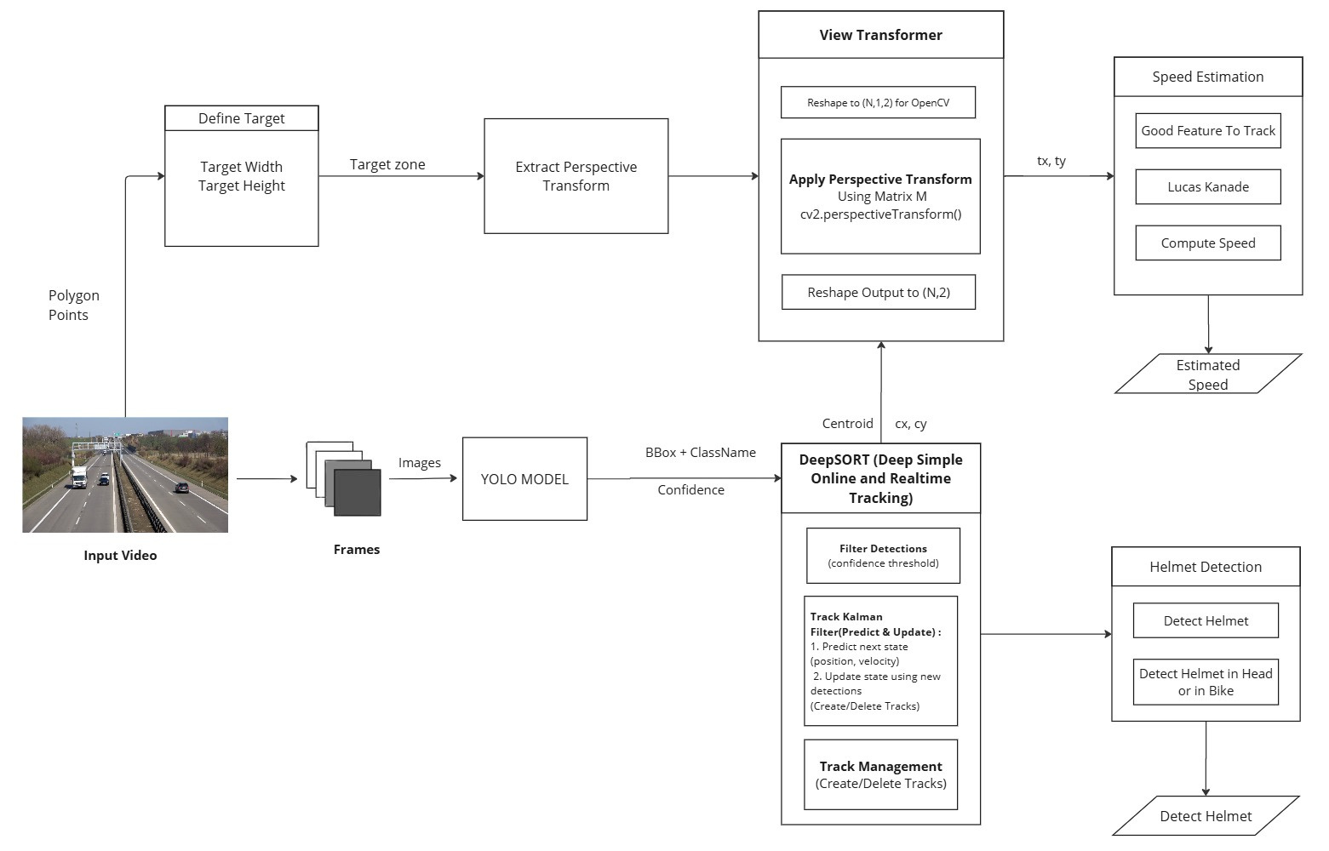
System Architecture

Slide 7

YOLO - You Only Look Once
YOLO (You Only Look Once) is a deep learning-based single-stage object detector that detects objects in real time by simultaneously predicting bounding boxes and class probabilities from the entire image
YOLO is fast and efficient for real-time object detection, processing the entire image in one pass.
Fig 1: Input and Output of YOLO

Slide 8
Deep-SORT
DeepSORT (Deep Simple Online and Realtime) applies a moving average-based Kalman Filter to smooth object trajectories and reduce noise in motion estimation.
Consistent Identity Assignment : It assigns and maintains a unique tracking ID for each detected object across frames, ensuring identity consistency even through partial occlusions.
State Prediction for Robust Tracking : The Kalman Filter predicts the next state (position and velocity) of each object, allowing the tracker to handle missed detections or temporary losses.

Slide 9
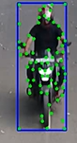
Shi-Tomasi Good Features to Track
Feature Point Detection: The Shi-Tomasi Good Features to Track algorithm identifies strong corner-like points in an image that are ideal for tracking due to their high contrast and spatial variation.
Robust Motion Estimation: These points are highly stable across frames, making them suitable for motion tracking techniques like Lucas-Kanade optical flow, which estimates how these features move over time.
Fig 2: Keypoints Detected Using Good Features to Track (GFTT)

Slide 10
Lucas-Kanade
Optical Flow Estimation: Optical flow refers to the pattern of apparent motion of objects or features between consecutive frames in a video, caused by the relative movement of the camera and scene.
Lucas-Kanade Method: The Lucas-Kanade optical flow algorithm estimates the motion of selected feature points (like corners) by assuming small, consistent motion within a local window. It solves a set of equations to find displacement vectors for each feature.
Used for Fine-Grained Tracking: When combined with Shi-Tomasi corners, it provides a reliable and computationally efficient method to track feature points across frames, enabling accurate motion estimation and object trajectory analysis.

Slide 11
IMPLEMENTATION

Slide 12
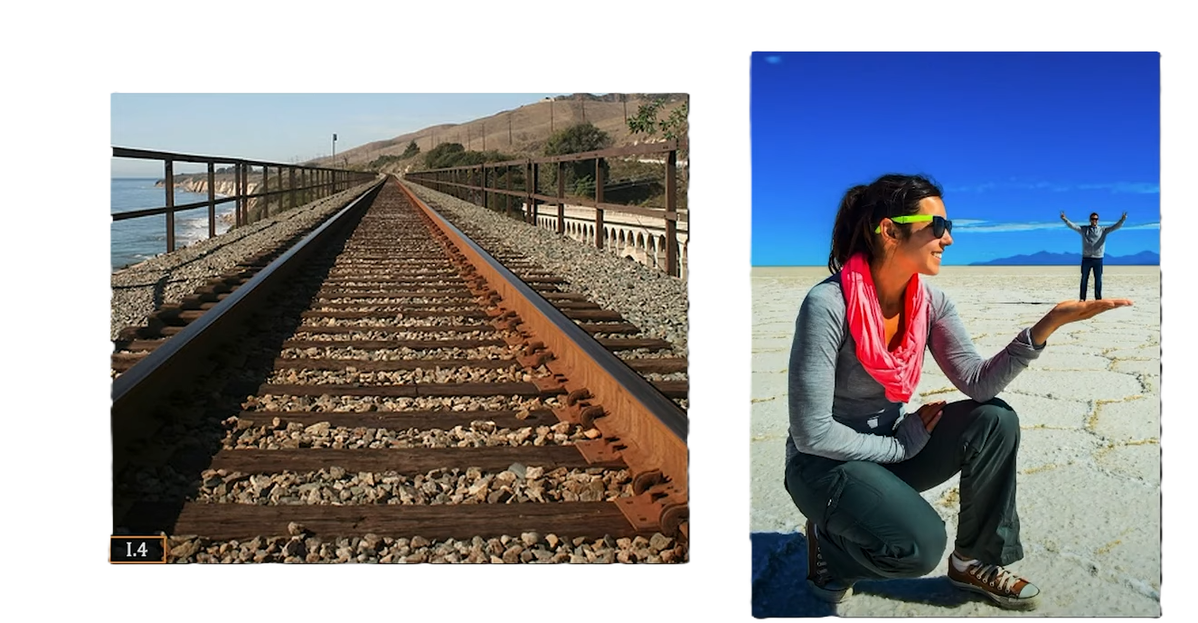
Module 1 - Speed Estimation:
Understanding Image Magnification :
If the object is closer, it appears larger in the image
If the object is farther, it appears smaller in the image
Fig 3: Visual Representation of Image Magnification

Slide 13
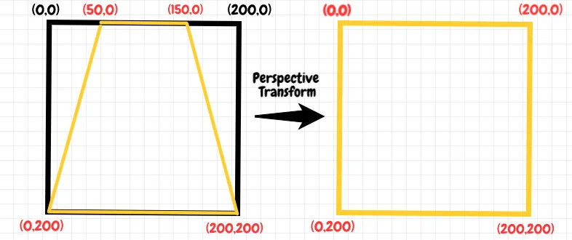
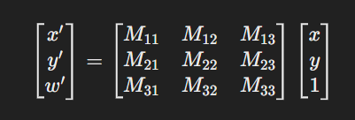
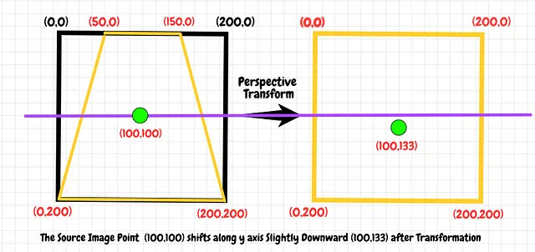
Module 1 - Speed Estimation:
Perspective Transformation :
Real-World Mapping: Converts pixel coordinates to a top-down (bird’s-eye) view to estimate real-world distances and object speeds accurately.
Preserves Geometry: Keeps straight lines and object positions intact, but not angles or sizes — useful for analyzing motion from different camera angles.

Slide 14
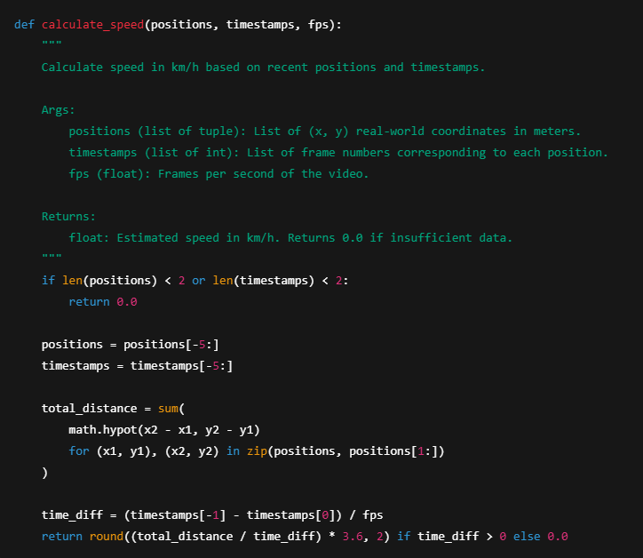
Speed Estimation :
Uses recent real-world positions (x, y) of tracked objects to compute total displacement.
Calculates Euclidean distance between consecutive positions to measure distance travelled.
Computes time elapsed using frame differences and video frames per second (fps).
Speed = (Total Distance / Time) converted to km/h for accurate velocity estimation.

Slide 15
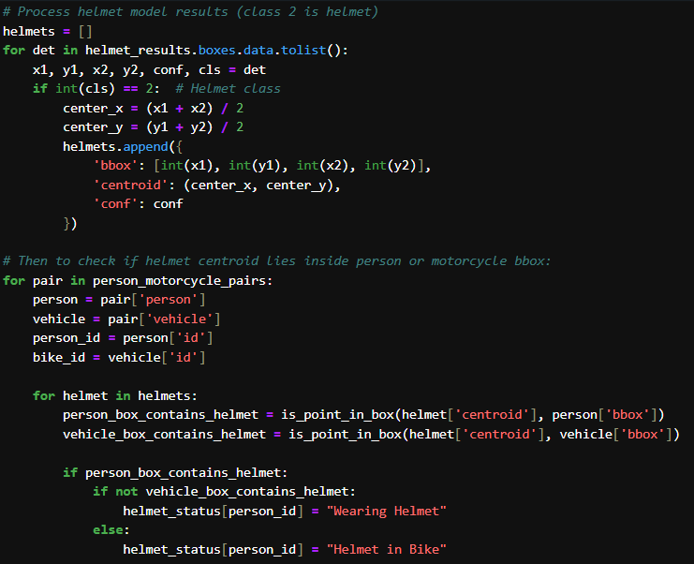
Helmet Detection Module :
Detect helmets using a dedicated YOLO model and extract bounding boxes with centroids.
Associate helmet centroids with persons and motorcycles by checking if centroids lie inside their bounding boxes.
Classify helmet status as "Wearing Helmet" or "Helmet in Bike" or “No Helmet” based on centroid location relative to person and bike boxes.

Slide 16
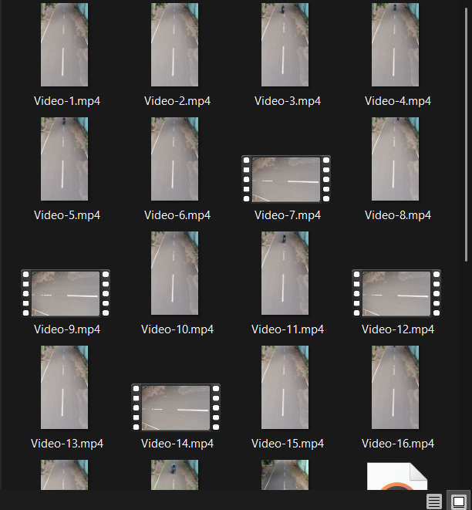
Dataset :
Utilized a custom dataset of 30 recorded videos, captured in-house, dedicated to vehicle speed estimation.
Employed the Kaggle “Bike Helmet Detection Computer Vision Project” dataset for helmet detection, supplemented with manually collected images to enhance model robustness.
Fig 4: Recorded Custom Dataset

Slide 17
Results and Evaluation

Slide 18
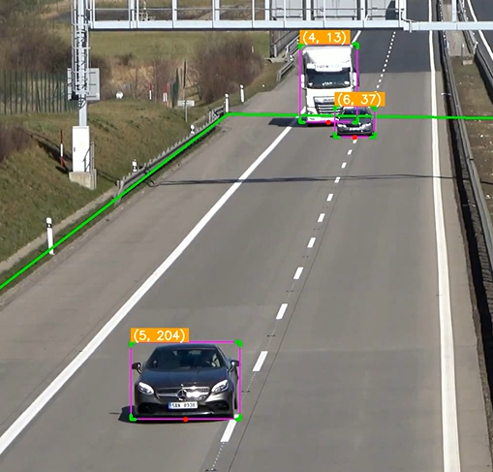
Speed Estimation:
Fig 5: Perspective Transformation

Slide 19
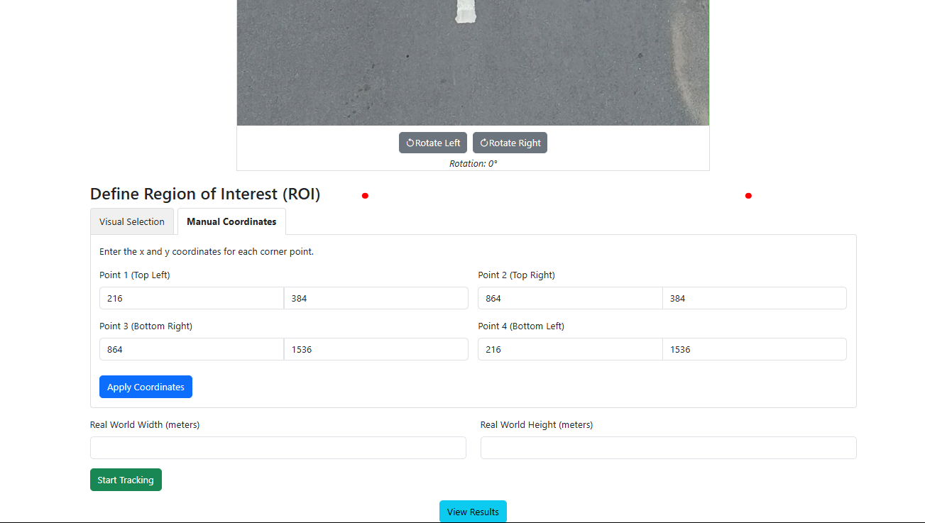
Speed Estimation:
Fig 6: Input for ROI and real world height and width

Slide 20
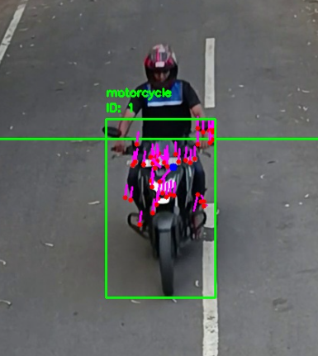
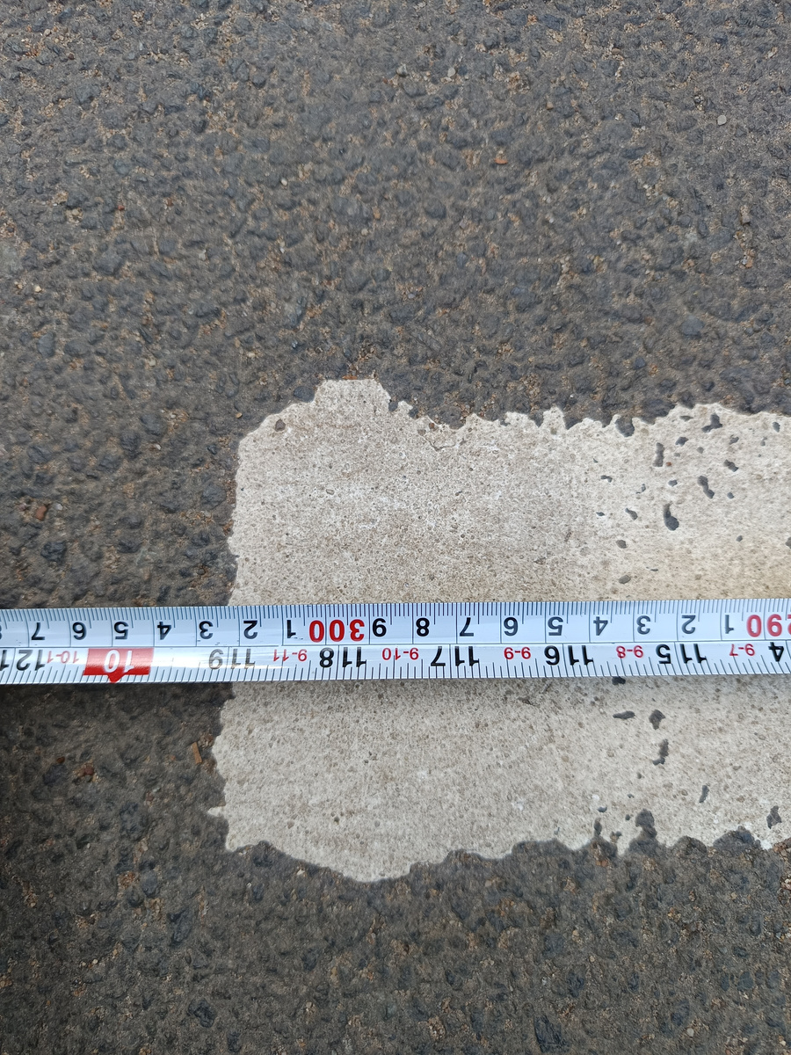
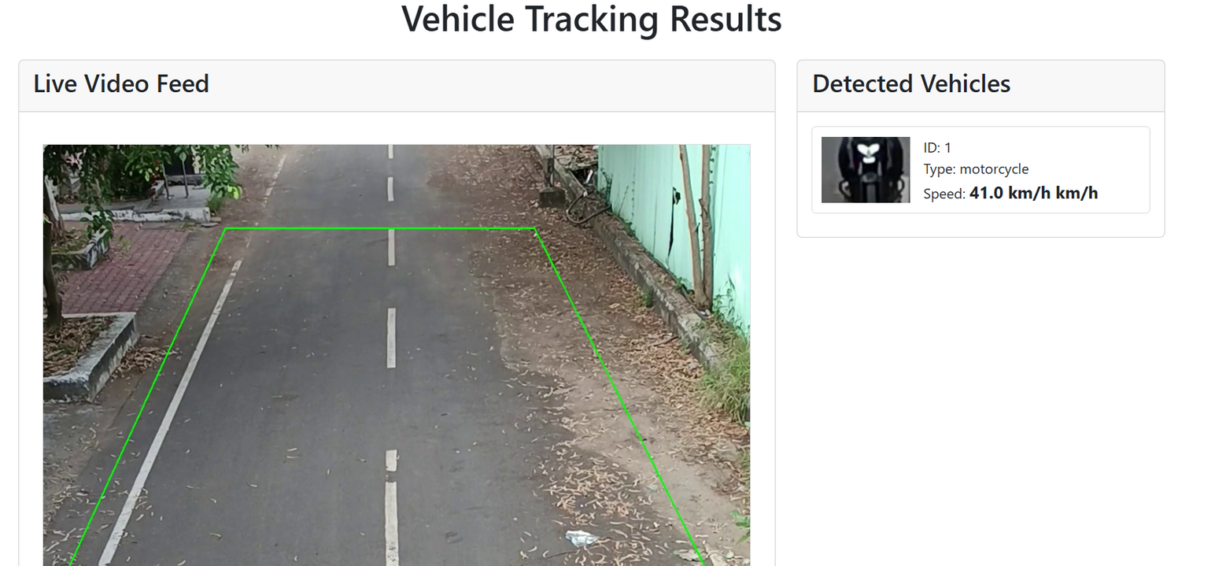
Speed Estimation:
Fig 7: Speed Estimated by pixel displacement using GFFT, Lucas Kanade
Fig 9: Manual Measurement of the Road
Fig 8: Estimated Speed

Slide 21
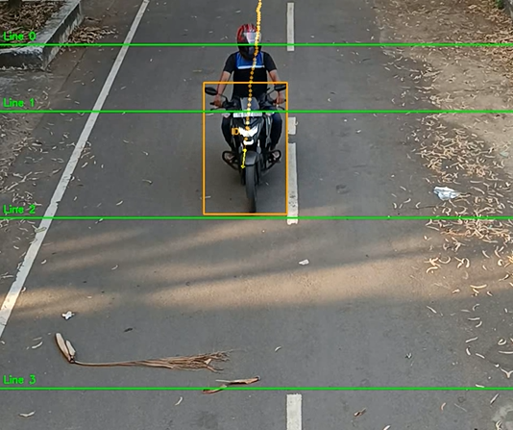
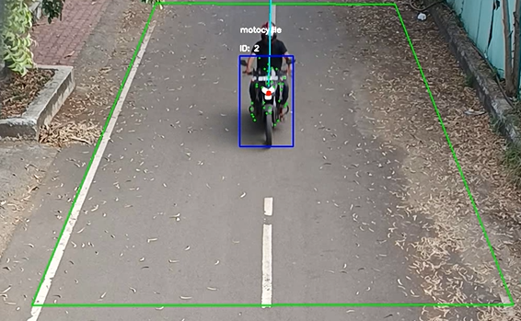
Speed Estimation:
Fig 10: Speed Estimation using 4 Virtual Lines
Fig 11: Speed Estimation using Perspective Transformation

Slide 22
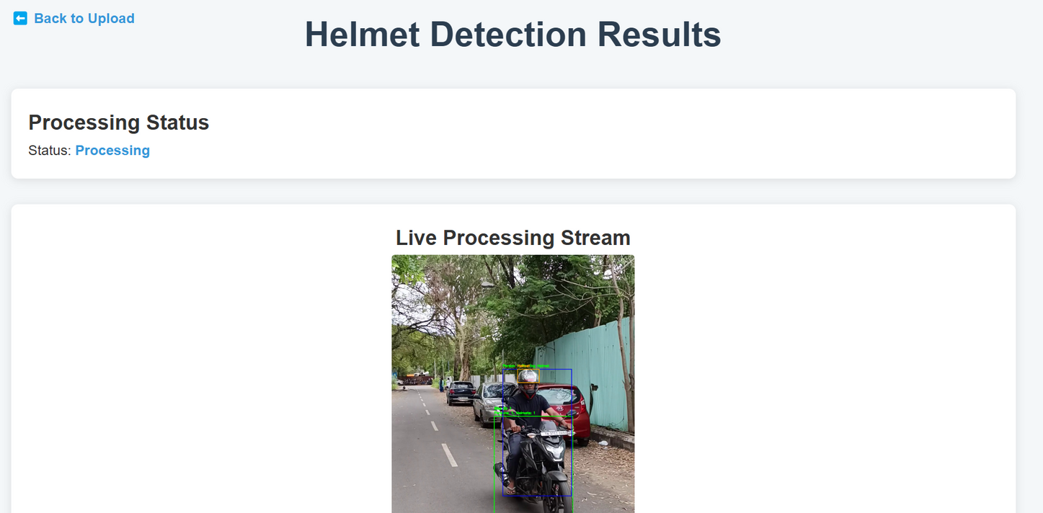
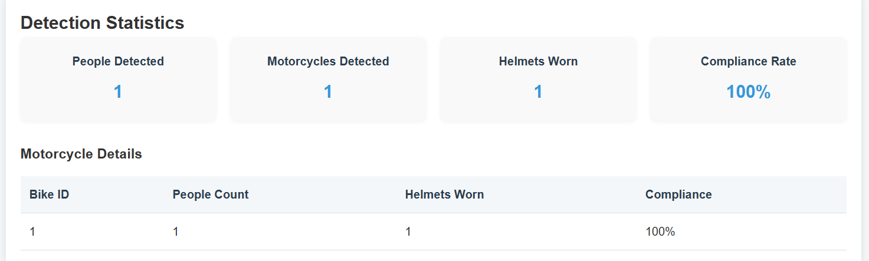

Slide 23
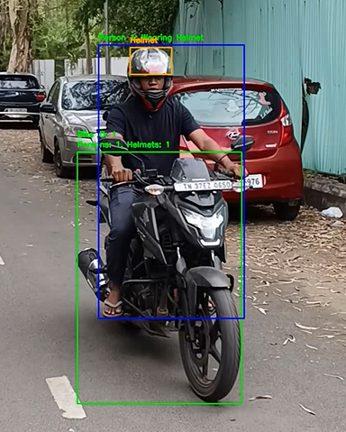
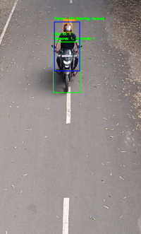
Helmet Detection:
Fig 12: Helmet Detection from height
Fig 13: Helmet Detection

Slide 24
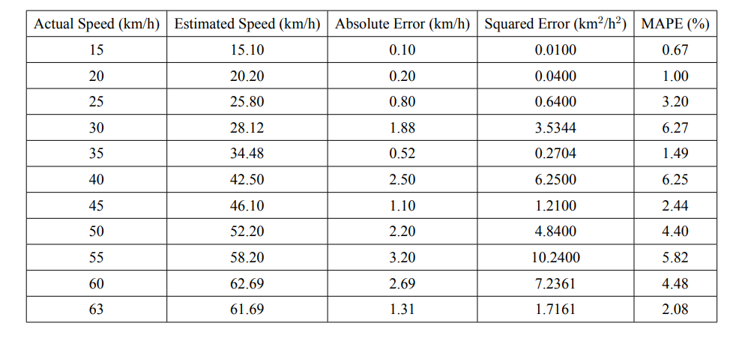
Module Performance Evaluation:
Table 1: Performance of the speed estimation module based on actual and estimated speeds with associated error metrics

Slide 25
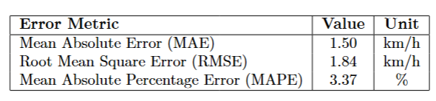
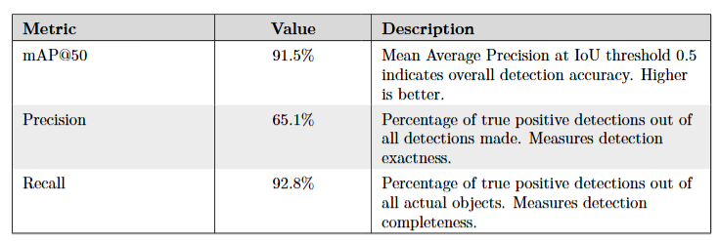
Module Performance Evaluation:
Table 2: Speed Estimation Error Metrics
Table 3: Performance Metrics for Helmet Detection Model

Slide 26
References
1) M. Chen et al., “A Framework for Analyzing Traffic Congestion Using Deep Learning Techniques,” Applied Sciences, vol. 12, no. 3, pp. 1354, 2022. Available: https://www.mdpi.com/2076-3417/12/3/1354.
2) A. Bewley, Z. Ge, L. Ott, F. Ramos, and B. Upcroft, “Simple Online and Realtime Tracking,” in Proceedings of the 2016 IEEE International Conference on Image Processing (ICIP), Phoenix, AZ, USA, 2016, pp. 3464–3468. DOI: 10.1109/ICIP.2016.7533003.
3) T.-H. Wu, T.-W. Wang, and Y.-Q. Liu, “Real-Time Vehicle and Distance Detection Based on Improved Yolo v5 Network,” in 2021 IEEE 3rd World Symposium on Artificial Intelligence (WSAI), Taichung, Taiwan, 2021, pp. 1–5. DOI: 10.1109/WSAI51899.2021.9486316.
4) R. Ke, C. Liu, H. Yang, W. Sun, and Y. Wang, “Real-Time Traffic and Road Surveillance With Parallel Edge Intelligence,” IEEE Journal of Radio Frequency Identification, vol. 6, pp. 693–700, 2022. DOI: 10.1109/JRFID.2022.3211262.

Slide 27
References
5) K. Sangsuwan and M. Ekpanyapong, “Video-Based Vehicle Speed Estimation Using Speed Measurement Metrics,” IEEE Access, vol. 12, pp. 4845–4859, Jan. 2024. DOI: 10.1109/ACCESS.2024.3350381.
6) M. Tahir, Y. Qiao, N. Kanwal, B. Lee, and M. N. Asghar, “Real-Time Event-Driven Road Traffic Monitoring System Using CCTV Video Analytics,” IEEE Access, vol. 11, pp. 139097–139110, Dec. 2023. DOI: 10.1109/ACCESS.2023.3340144.
7) E. Güney, C. Bayılmış, and B. Çakan, “An Implementation of Real-Time Traffic Signs and Road Objects Detection Based on Mobile GPU Platforms,” IEEE Access, vol. 10, pp. 86191–86203, Aug. 2022. DOI: 10.1109/ACCESS.2022.3198954.

Slide 28

Thank you

